Slide 1
User Interface Development Overview
Web User Interface Development is the skill of creating content and visual controls that can be delivered to an end-user in a functional and accessible manner.
The field of user interface development concentrates on the following:
Usability – The front-end construction of all web sites is about more than just writing “simple” HTML mark-up, it’s about bringing the work of great management, information design, writing, and creative to life within the browsing device and about creating a usable experience for all visitors to enjoy (and hopefully return to). Usability refers to the study of the principles behind an object’s perceived efficiency or elegance. The UI developer must put careful thought into the usability of a web site and how the end-user will interact with the page they are viewing.
Accessibility – Usability then naturally leads to accessibility. Not just for the blind or the deaf (a popular misconception when the word “accessible” is used), but accessibility for everyone! How will the site render on mobile devices? Will it work without the aid of JavaScript? Will using Flash on your site be a problem for iPad users (Yes)? All of these questions, and many more, fall under accessibility. At TMP we strive to make sure our sites are as user friendly and as accessible as can possibly be.
Standards – The web has changed drastically since the dark days of browser wars and fly by the seat of your pants web development. The industry is now maturing. This is due in large part to the advent and adoption of web standards. Building with web standards is equivalent to making sure you pour the foundation before building the house. A good User Interface developer or designer must adhere to these rules as closely as possible when writing the underlying code for a web site. Web sites built with standards are also generally more accessible and much easier to maintain.
Progressive Enhancement – Web sites are no longer tied to browsers on our desktops. With the arrival of the mobile web and access to web sites on many different devices it is now more important than ever to make sure our web sites are reaching as wide an audience as possible. Progressive Enhancement (PE) is the key to making this happen. By building a strong foundation and layering in design and functionality intelligently, we can ensure that our message is being received by many users.
TMP Worldwide. The Digital Brand Authority.

Slide 2
Methodologies
Input/Tools/Output
  Estimate
  Overview & Research
  Implementation
Scope, Discovery (if applicable)‏
Scope, Sitemap, Wireframes, Business Rules, Content and Creative (Comps)‏
Wireframes, Sitemap, Business Rules, Content Deck and Creative (Comps)‏
TMP Worldwide. The Digital Brand Authority.
Notes:
UI and/or Flash Developers should always be brought into the development process early on to flag potential issues before IxD and Creative hand off materials to the client for review. This helps a great deal in ironing out usability, accessibility or technical issues before development gets underway.

Slide 3
Input – Kaiser Permanente Careers Site
Experience Design Documents | Content | Design (Comps)‏
These documents help comprehend:
Purpose of the site
Functionality of the site
Design (Look & Feel) of the site
TMP Worldwide. The Digital Brand Authority.
Notes:
The EDD, Designs, and Content received from the IxD and Creative departments are imperative to the continued development of a website. These documents will be used to create the final user interface templates that will be handed off to the back-end developers for middle tier and database integration.
The EDD presents the overall functionality and structure of a web site.
The content defines the purpose and structure of each page within the website.
The design (a.k.a. comps) present the final look and feel of the completed templates.

Slide 4

Tools/Techniques
Coding with Web Standards
The three user interface layers of a website:
HTML (Hypertext Mark-up Language) – The Structural Layer
CSS (Cascading Style sheets) – The Presentation Layer
JavaScript – The Behavioural Layer
TMP Worldwide. The Digital Brand Authority.
Notes:
Before we jump in, let’s present a more simplified view of UI development for the non-technical readers in the audience. Simply put, Web User Interface development can be compared to making a birthday cake. That may sound odd, but it really is just like that. First, you have the most important part, the cake itself, which defines the base structure of our sites. In our case, this is the HTML, in which no site can exist without. Then come the icing and sprinkles (and don’t forget those yummy flowers). This is the look and feel of the site, the presentation layer defined in the CSS. And last, but certainly not least, are the sparklers (or stick of dynamite if you are not careful); the behavioral layer, which is the JavaScript that gives your site its functional pizzazz. All three technologies, kept separated from each other, but delivered together to create the entire site experience. This, in essence, is what modern day interface development is all about. Once you grasp this concept, you’ll understand what it takes to develop rock solid, powerful and accessible user interfaces. Are you hungry for more? Read on!

Slide 5
Tools/Techniques
Experience Design Document Review
An EDD Review will:
Help define business rules
Allow potential functionality issues to be flagged sooner rather than later
Allow for assignment of page names
TMP Worldwide. The Digital Brand Authority.
Notes:
The development team will then review the EDD to flesh out the site even further and make any additional modifications if needed.
It is during this review that the user interface developer will determine how best to implement certain pieces of client-side functionality. Questions on how best to deliver the site are usually ironed out here. Should Flash be used or can the same functionality be achieved with JavaScript instead, etc.?
Also during this phase, careful thought will be placed on how best to build the page or site with a technique known as progressive enhancement. Progressive enhancement (or “PE” for short) is a web development strategy used to build sites with baseline devices in mind while layering in a richer experience for users with more modern browsers.
Building with progressive enhancement at the forefront of our thoughts will allow us to create web sites that are compatible with different devices, easier to maintain and which free us from having to build websites that look exactly the same across different browsers.
(Lynda, I’m thinking PE should be it’s own slide. What do you think?)

Slide 6
Tools/Techniques
Content Review
The Content Review determines:
How the page will be laid out structurally and semantically, using HTML.
TMP Worldwide. The Digital Brand Authority.
Notes:
The content review is performed by the individual user interface developer.
Since a website is essentially defined by its content, this step is of the utmost importance. Heavy emphasis must be placed on content early in the game - perhaps even earlier than creative at times. It is here that the UI developer should begin writing the HTML that will define the page.
When the content is carefully analyzed, the page can then be logically structured and the appropriate placement of headings, paragraphs, images, etc. can then be determined.
In addition to this, proper HTML elements will also be used to give more semantic meaning to certain parts of th the content. For example, if the content contains a paragraph with words that require emphasis, there are HTML elements that exist to place the extra emphasis needed to convey that message to search engines and devices used by the blind to read web pages.
Unfortunately, the extra attention that content deserves is probably the most overlooked part of development. Content is king and we should take extra care to treat it as such.

Slide 7
Tools/Techniques
Design Review
The Design Review is used to:
Identify potential browser issues
Determine best optimization techniques
TMP Worldwide. The Digital Brand Authority.
Notes:
The design review is performed on the completed design to determine how best to slice up any imagery with Adobe Photoshop and optimize the layout for the web. It can also be used as an opportunity to flag potential browser issues that may arise from an overly complex design and to further determine what may or may not be achievable with user interface technologies such as CSS and JavaScript.

Slide 8
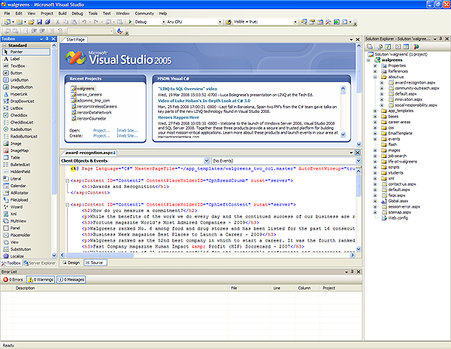
Tools/Techniques
Microsoft Visual Studio
Functionality:
Build Graphical User Interfaces
Benefit:
Allows UI developer to toggle between code and design mode and easily monitor progress of page development.
Drag and drop of form and other user controls make development a snap.
TMP Worldwide. The Digital Brand Authority.
Notes:
Visual Studio is an integrated development environment (IDE) from Microsoft. It can be used to develop console and graphical user interface applications along with Windows Forms applications, web sites, web applications, and web services for all platforms supported by Microsoft Windows, Windows Mobile, Windows CE, .NET Framework and .NET Compact Framework. In addition to Visual Studio, other popular editors include IDM’s UltraEdit Professional Text/HEX Editor and Adobe Dreamweaver. Even Microsoft’s NotePad will do in a pinch if needed.

Slide 9
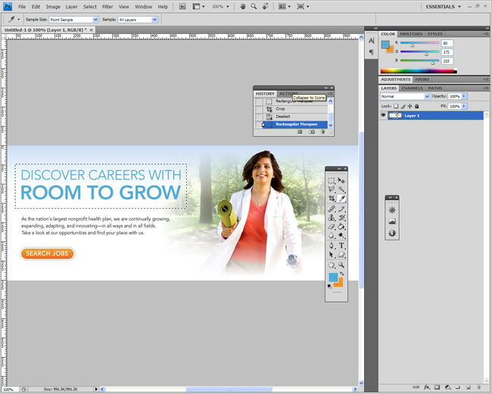
Tools/Techniques
Adobe Photoshop
Functionality:
Graphic Editing Program
Benefit:
The de facto software for creating, modifying and optimizing images for the web.
TMP Worldwide. The Digital Brand Authority.
Notes:
Adobe Photoshop, or simply Photoshop, is a graphics editing program developed and published by Adobe Systems. It is the current market leader for commercial bitmap and image manipulation software, and is the flagship product of Adobe Systems.

Slide 10
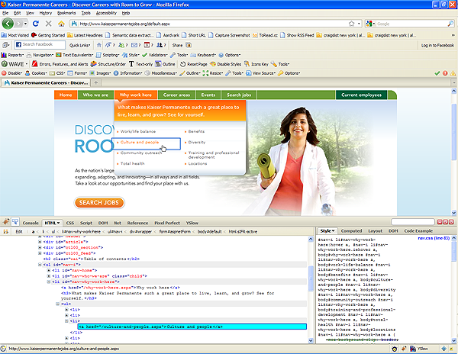
Tools/Techniques
Firebug
Functionality:
Web page code editor and debugger.
Benefit:
Inspect and edit HTML
Tweak CSS
Monitor network activity
Debug, profile and log JavaScript
Quickly find errors
TMP Worldwide. The Digital Brand Authority.
Notes:
Firebug is a Firefox browser add-on that allows developers to edit, debug, and monitor CSS, HTML, and JavaScript live in any web page. This tool is an indispensable part of any web developers tool kit. Other browsers have similar web development add-ons, like Microsoft’s Internet Explorer Development Toolbar (Whew!) and Opera Dragonfly.

Slide 11


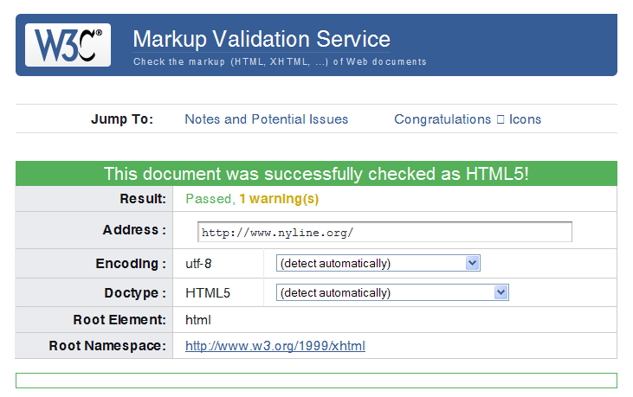
Tools/Techniques
More Tools
Accessibility:
NVDA Screen Reader
Windows Eyes
Firefox Accessibility Extension
Web Accessibility Evaluation (WAVE) Add-on for Firefox
Validation:
The W3C Validator (http://validator.w3.org/)‏
Xenu’s Link Sleuth
TMP Worldwide. The Digital Brand Authority.
Notes:
Building a more accessible website is easier than ever before now that we have more tools at our disposal. In addition to the many wonderful Firefox extensions already mentioned, screen readers are also used during the development process to improve accessibility. Developers should also validate their pages upon completion to avoid any potential development issues throughout the development process (Many a late night has been spent attempting to figure out why a page may be breaking.) A good old link scan with Xenu, at the end of development, can also be very helpful in ensuring better usability and search engine optimization.

Slide 12
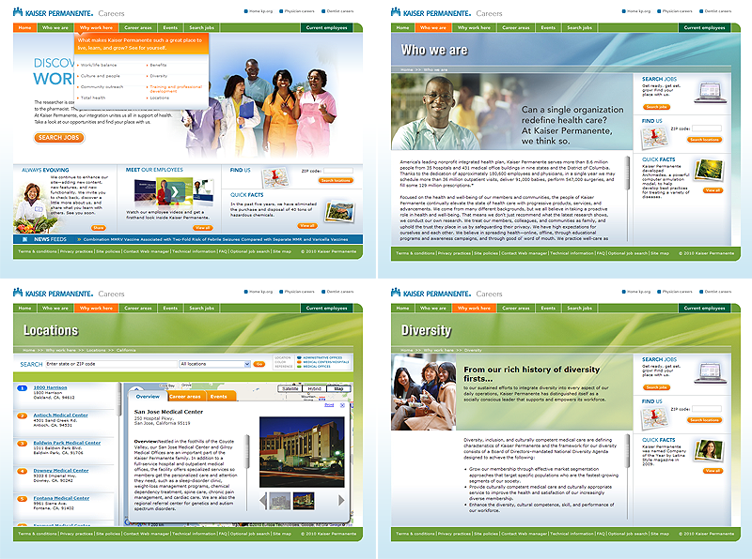
Output
Templates
Purpose:
Controls the overall look and feel of a website
Provides the framework that brings together common elements, modules and components.
TMP Worldwide. The Digital Brand Authority.
Notes:
User Interface templates are now ready to for integration! If we have done our jobs right then we should be handing off a usable, accessible, structurally sound and progressively enhanced user interface for all to enjoy and interact with.

Slide 13
Questions
1. Who is web accessibility geared towards?
A. Handicapped Individuals
B. Ipad Users
C. Everyone
D. Mobile Web Users
2. What are the three user interface layers of a website?
3. What does the content review determine and why is it so important?
4. What are three benefits of building a website with progressive enhancement?
A. Site can be made compatible with different devices.
B. Site is easier to maintain
C. Browser issues become obsolete
D. All of the above
TMP Worldwide. The Digital Brand Authority.
Notes:
1. Who is web accessibility geared towards?
C. Everyone
2. What are the three user interface layers of a website?
HTML, CSS, and JavaScript
3. What does the content review determine and why is it so important?
The content review determines how the page will be laid out structurally and semantically, using HTML. It is important because content is essentially the most important part of a web page.
4. What are one of the benefits of building a website with progressive enhancement?
D. All of the above

Slide 14
Resources
Websites
http://www.alistapart.com/
http://www.webstandards.org/
http://www.sitepoint.com/
Blogs
http://www.zeldman.com/
http://www.meyerweb.com/
Mailing Lists
http://www.webstandardsgroup.org/
http://www.css-discuss.org/
Books
Designing with Web Standards By Jeffery Zeldman
Designing with Progressive Enhancement By Todd Parker, Patty Toland, Scott Jehl and Maggie Costello Wachs
TMP Worldwide. The Digital Brand Authority.

